Slide 1
Netflix Data: Cleaning, Analysis, and Visualization
Deepak Sharma : UMIP26033

Slide 2
Conclusion
In this analysis, we explored various aspects of the Netflix Dataset using Python and Pandas. We performed data cleaning, answered specific questions about the dataset, and visualized trends using graphs and plots. This analysis provides insights into the types of content available on Netflix, the distribution of releases, and even specific details about movies, TV shows, directors, and ratings, enabling better informed business decisions within the entertainment industry.
the majority of Netflix content leans towards movies, with drama as the dominant genre, primarily produced in the United States, which can inform strategic decisions regarding content acquisition, marketing, and personalization efforts to cater to diverse audience tastes across different regions.

Slide 3
Table Of Content
1. Introduction
2. Problem Statement
3. Technique Used to Solve the problem
4. Result/Output
5. Conclusion

Slide 4
Project Overview
This project involved loading, cleaning, analyzing, and visualizing Netflix data. The cleaned dataset was prepared using Python libraries like Numpy, Pandas, Matplotlib, and Seaborn were utilized for data analysis and visualization.

Slide 5
Introduction
Netflix is a leading global streaming platform offering a diverse catalog of movies, TV shows, and original content. This project focuses on analyzing a dataset containing information about Netflix content added between 2008 and 2021. By leveraging data cleaning and visualization techniques, the project aims to uncover trends and insights about Netflix's growing library of entertainment.
The objective is to demonstrate expertise in data cleaning, analysis, and visualization using modern tools and technologies. This dataset also provides a foundation for exploring potential machine learning applications in the future.
Tools like Python & Jupyter Notebook were used to clean and visualize the data, while libraries like NumPy, Pandas, Matplotlib, and Seaborn helped derive meaningful insights.

Slide 6
Problem Statement
Analyzing Netflix's vast dataset of movies and TV shows requires a systematic approach to address several key challenges:
Data Quality Issues: The dataset contains missing values, duplicates, and inconsistencies that need to be cleaned for accurate analysis.
Unstructured Information: Columns with combined data (e.g., genres, countries) require splitting and reorganization for better usability.
Insight Extraction: The dataset must be explored to uncover meaningful trends, patterns, and metrics about Netflix content over time.
Effective Documentation and Analysis: Using Jupyter Notebook for an interactive and well-documented workflow to combine code, analysis, and visualization in one environment.
This project uses Python libraries like NumPy, Pandas, Matplotlib, and Seaborn within Jupyter Notebook to clean, analyze, and visualize the data, enabling insights into Netflix's content trends and preparing the dataset for further applications.

Slide 7
Tools Used to Solve the Problem
- Python
- Excel
- Jupyter Notebook
- Libraries: NumPy, Pandas, Matplotlib, Seaborn

Slide 8
Data Cleaning Steps
1. Treating Nulls
2. Handling Duplicates
3. Populating Missing Rows
4. Dropping Unneeded Columns
5. Splitting Columns

Slide 9
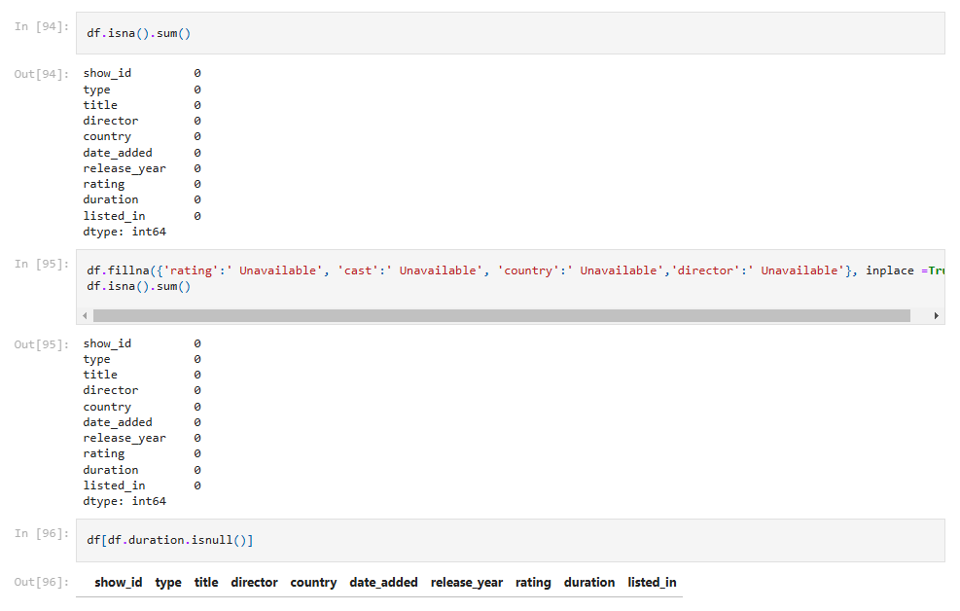

Slide 10
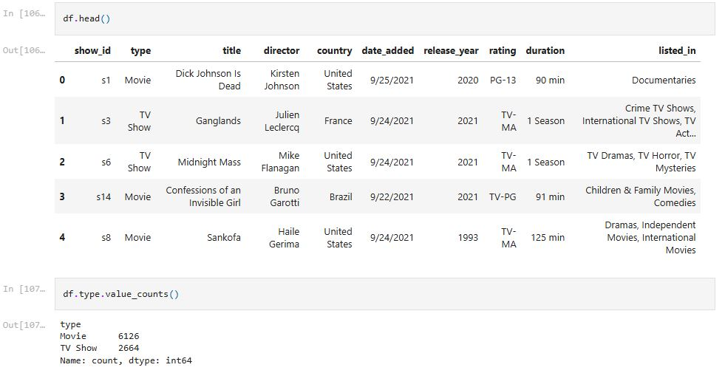
Data Analysis and Visualization

Slide 11
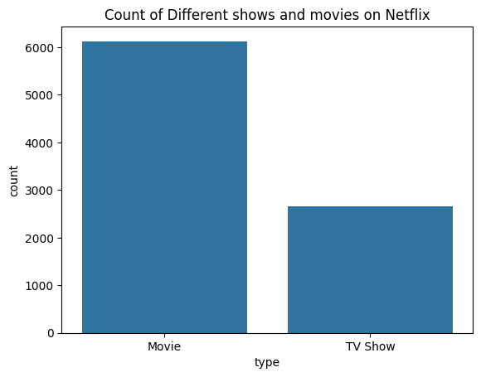
Result/Output
Insights from the Graph
Content Distribution: The bar chart highlights that Netflix has a significantly higher number of Movies (6,126) compared to TV Shows (2,664).
Dominance of Movies: Movies make up the majority of the platform's content, roughly 70%, indicating a focus on single-episode entertainment rather than serialized content.
TV Show Presence: While fewer in number, TV shows still constitute a substantial portion, catering to binge-watchers and fans of episodic storytelling.
This is a Bar Chart, a suitable visualization for comparing categorical data & height of each bar represents the count of items in each category, making it easy to compare the number of Movies vs. TV Shows on Netflix.

Slide 12
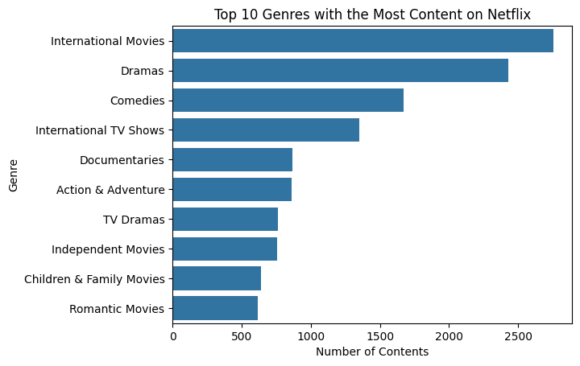
This horizontal bar chart represents the Top 10 Genres with the Most Content on Netflix based on the number of items available.
Insights from the Graph
International Movies Lead: Over 2,500 titles, showcasing Netflix’s global content strategy.
Popular Genres: Dramas, Comedies, and International TV Shows attract diverse audiences.
Varied Offerings: Documentaries, Action & Adventure, and Children & Family Movies cater to niche and young audiences.
Balanced Content: A mix of movie genres (e.g., Romantic Movies) and TV genres (e.g., TV Dramas) reflects Netflix's broad focus.

Slide 13
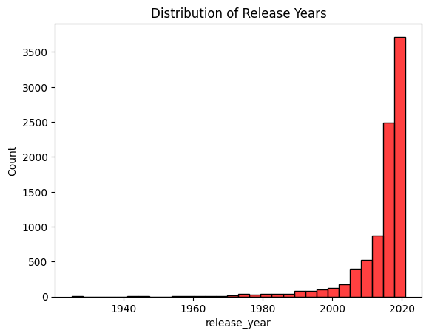
Histogram: This visualization effectively displays the frequency of content release years, helping to identify trends and patterns over time.
Insights from the Graph
Recent Content: Most Netflix titles are from the 21st century, with a sharp rise after 2010. Peak releases occurred in 2020.
Older Content: Minimal content before 1980, focusing on modern titles.
Growth Trend: Steady increase in content from the 1980s to 2000s as digital streaming gained popularity.

